Slide 1

Stock Market Analysis
Comprehensive analysis of trader performance, portfolio returns, and market trends using advanced financial metrics and data-driven insights

Slide 2

Project Overview
Objective
Approach
Analyzing stock market data to understand trader performance, portfolio returns, and overall market trends through key financial metrics including Sharpe ratio, win rate, volatility, and returns.
Stock price movements (open, high, low, close) were studied to identify trends and support better trading decisions. Insights were presented through clear visualizations to enable informed, data-driven investment strategies.

Slide 3
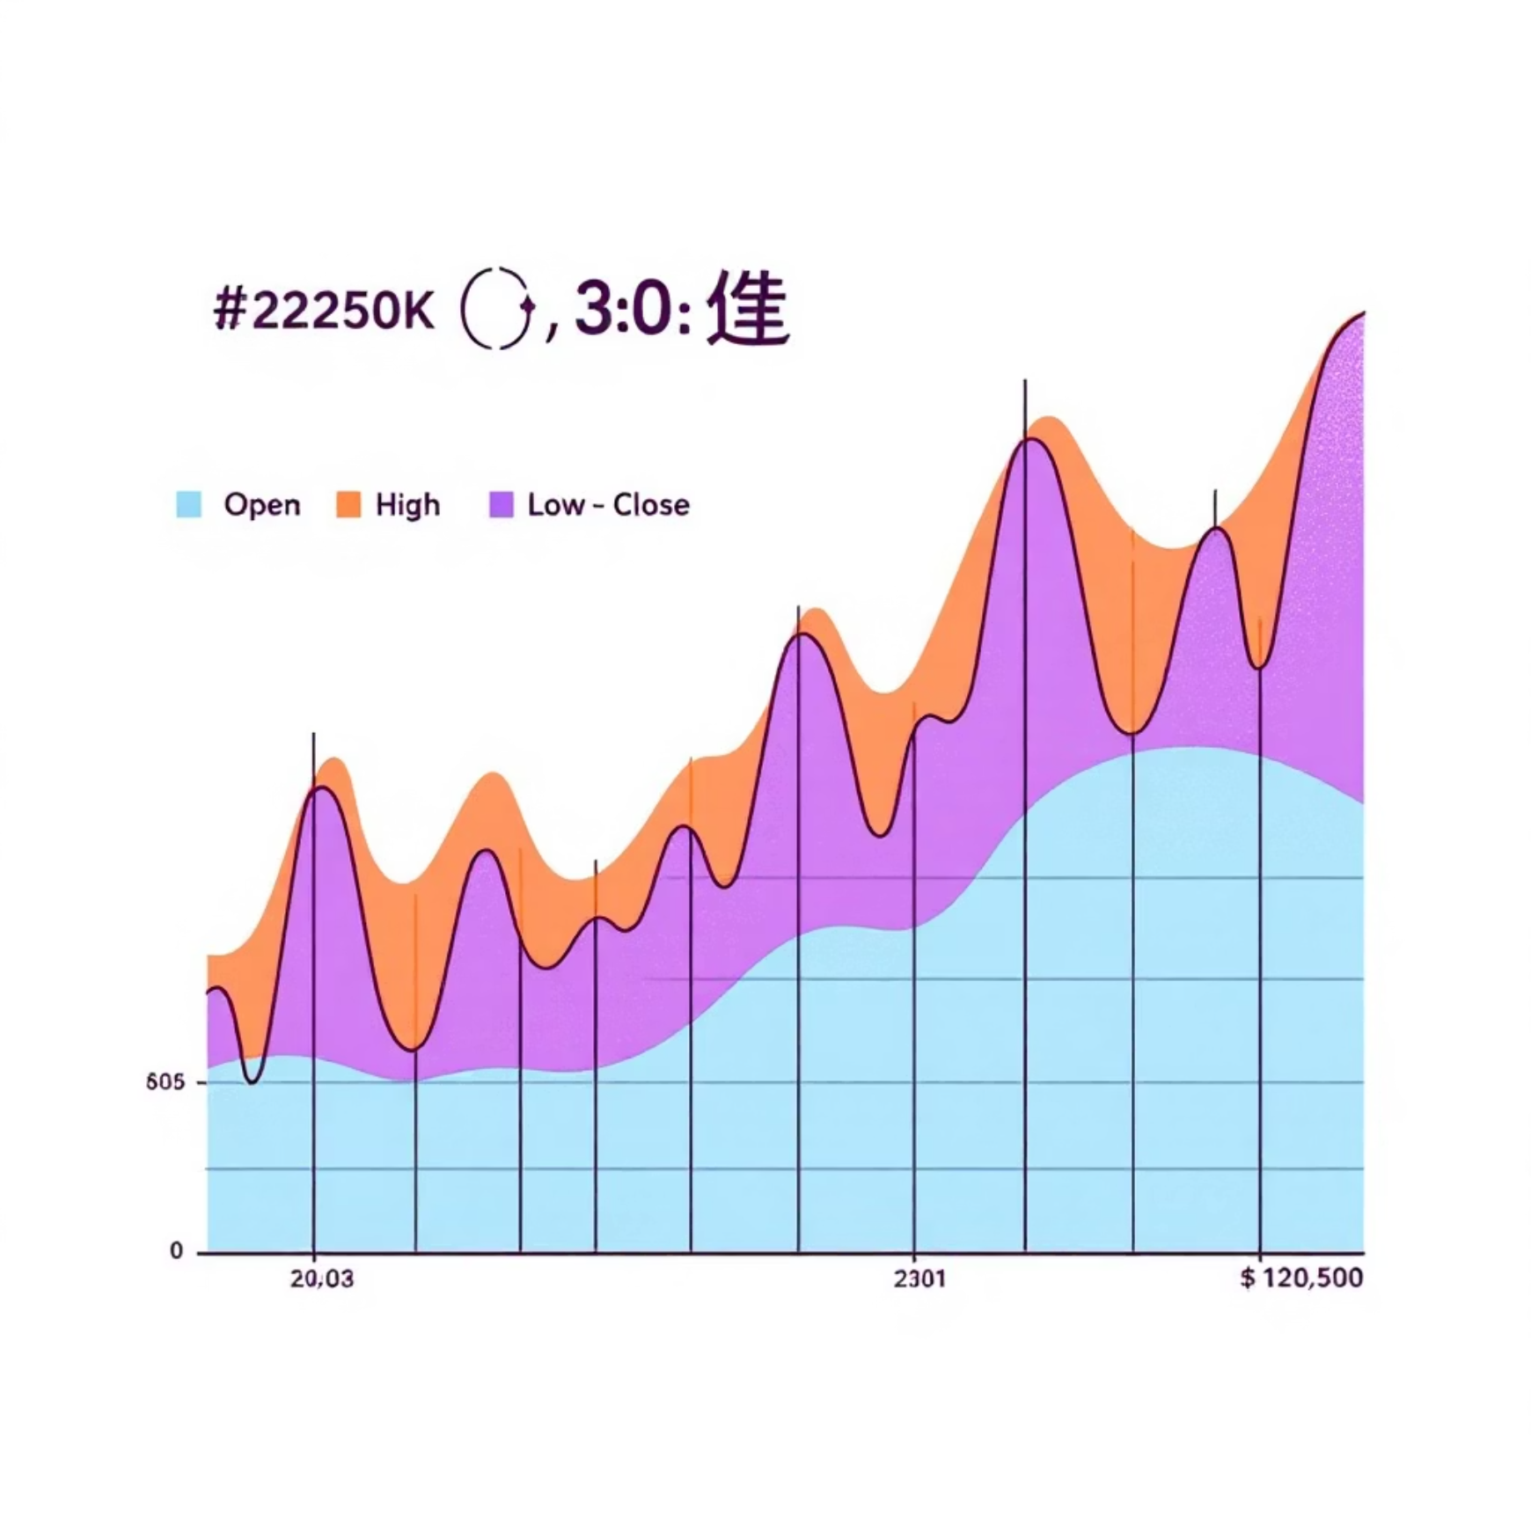
Dataset Structure
Core Tables
Key Identifiers
Time Series Data
Multiple sheets including fact_order and related dimension tables containing trader, company, and portfolio data
trader_id, company_id, portfolio_id enabling comprehensive cross-referencing and analysis
Date fields supporting trend analysis and performance tracking over time
Critical Price Metrics
Open Price: Trading session start price
High Price: Peak price during session
Low Price: Minimum price reached
Close Price: Final price for performance evaluation
Volume: Trading activity and market interest indicator

Slide 4


Data Processing & Preparation
01
02
03
Data Quality Assessment
Extraction & Transformation
Power Query Validation
Dataset verified as clean with no missing values . Data types validated for consistency across date, numeric prices, and volume fields.
Relevant stock-related columns extracted to focus on performance analysis. Data transformed to support proper modeling for advanced analytics.
Date formats and price consistency verified. Abnormal values in price and volume checked. Uniform stock symbols and column naming ensured.

Slide 5



Portfolio Performance Metrics
26.11M
270M
94M
Avg Trading Volume
Market Capitalisation
Portfolio Value
Strong market participation and liquidity
Total market value of portfolio stocks
Current total investment value
99.68%
47.80%
0.09
Portfolio Return
Trade Win Rate
Volatility
Portfolio has nearly doubled in value
Percentage of profitable trades
Moderate market risk level

Slide 6
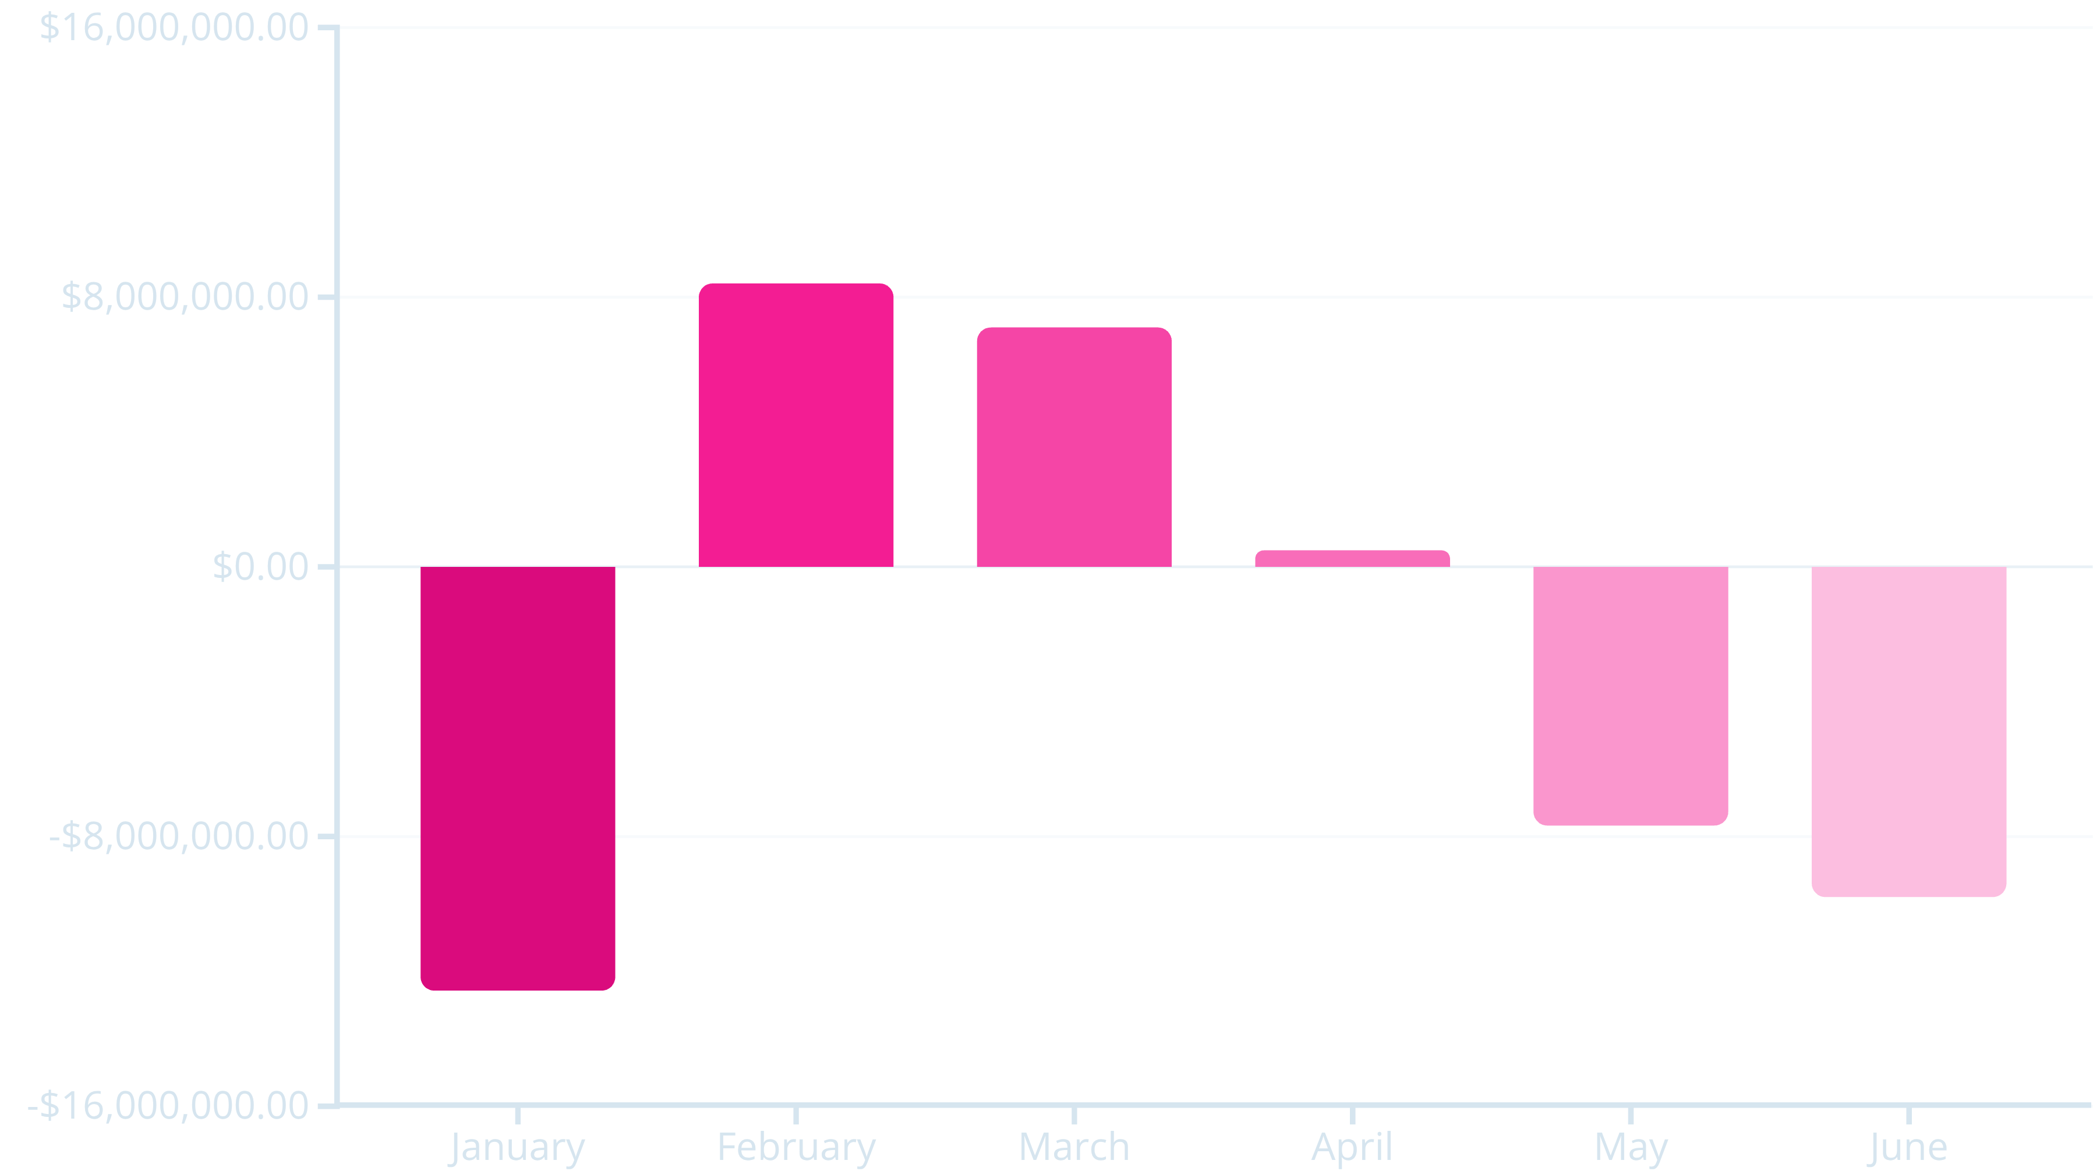
Monthly Performance Analysis
The chart shows month-wise profit and loss from January to June. January and June record significant losses, while February shows the highest profit, indicating strong performance. March remains profitable but slightly lower, and April is almost break-even. Overall, the pattern reflects high volatility, with strong gains in the middle months followed by a decline, highlighting the need for better cost control and more consistent revenue strategies.
Strong Performance Months
Challenging Periods
February (+$8.4M) and March (+$7.1M) recorded the highest profits, aligning with stable market conditions and strong returns. April showed marginal profit (+$0.5M), indicating reduced trading efficiency.
January (-$12.6M), May (-$7.7M), and June (-$9.8M) recorded significant losses, indicating reduced performance during volatile or unfavorable market phases.

Slide 7
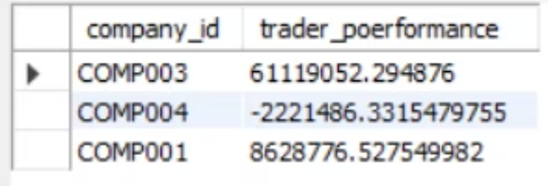
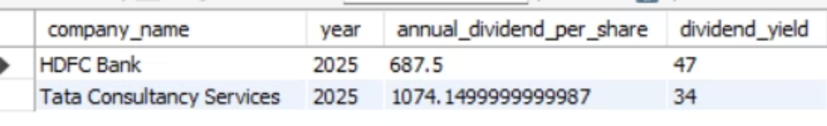
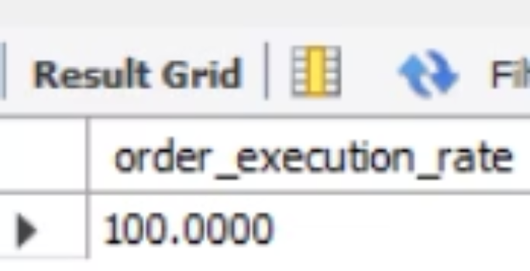
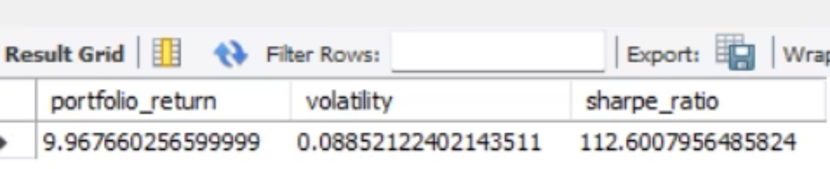
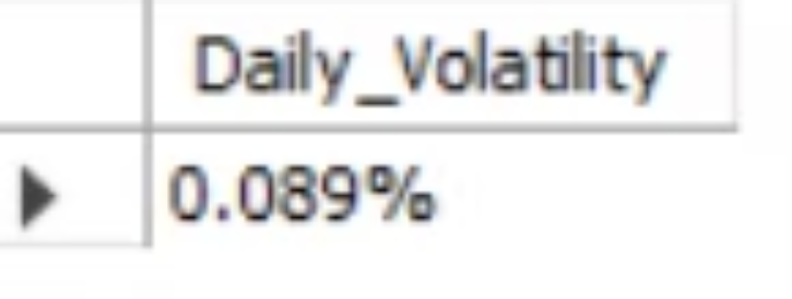
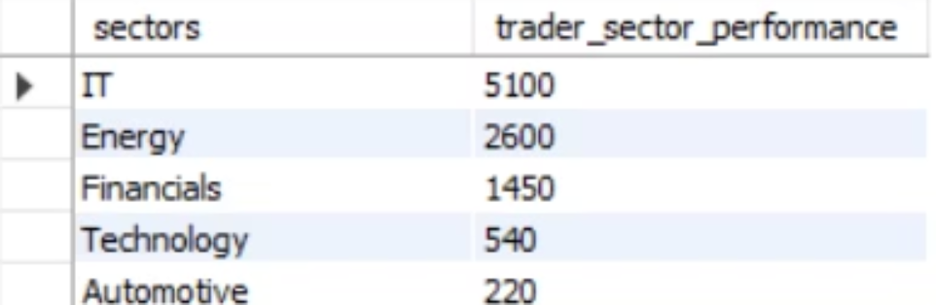
Sql Queris

Slide 8
Technical Challenges
Power BI Data Modeling
Tableau Relationship Conflicts
Faced significant difficulty in data modeling due to the dataset's snowflake schema structure with multiple fact tables and dimension tables, which made relationship management and maintenance complex and time-consuming.
Encountered challenges creating relationships in Tableau, as the platform does not support complex snowflake schemas effectively. This caused relationship conflicts and prevented proper linkage between tables, requiring alternative solutions.

Slide 9




Key Strategic Insights
Stable Market Performance
The portfolio delivered strong returns during stable market conditions (February-March), demonstrating effective trading strategies during low-volatility periods.
Volatility Impact
High volatility periods like June significantly impacted trader performance. Volatility does not always guarantee profit, emphasizing the need for adaptive risk management.
Concentration Risk
Sector concentration boosted returns but increased exposure risk. Diversification is critical to mitigate downside during market corrections.
Market Trend Following
Traders closely follow market trends, highlighting the importance of volatility-aware strategies and dynamic portfolio rebalancing.

Slide 10

Conclusions & Recommendations
Key Takeaways
The analysis reveals that while the portfolio delivered exceptional returns (99.68%), performance was highly dependent on market conditions. Strong gains during stable months were partially offset by significant losses during volatile periods.
Strategic Recommendations
Enhance diversification to reduce sector concentration risk
Implement volatility-aware strategies for high-risk periods
Develop defensive positions during identified loss-prone months
Optimize trade timing based on historical performance patterns

Slide 11




Interactive Dashboard Overview
Comprehensive Power BI dashboard integrating all key metrics, monthly performance trends, and trader analytics. The dashboard provides real-time insights into portfolio value, win rates, volatility measures, and market cap trends, enabling quick decision-making and performance monitoring.
Dynamic Filtering
Interactive filters by trader, time period, and stock symbol
Trend Visualization
Time-series charts showing performance patterns
KPI Tracking
Real-time monitoring of critical financial metrics

Slide 12
